Slide 1
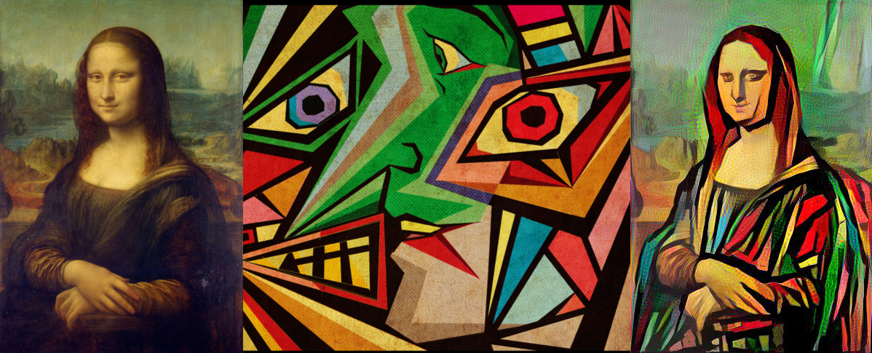
Extensions to Neural Style Transfer
CSCI 566
Deep Learning and its Applications
Team : 4D Tensor
Praveen Iyer, Sneha Bandi, Swarnita Venkatraman, Neha Chawla
Guiding TA: Bingjie Tang
Notes:
Hi,
We are Team 4D Tensor

Slide 2
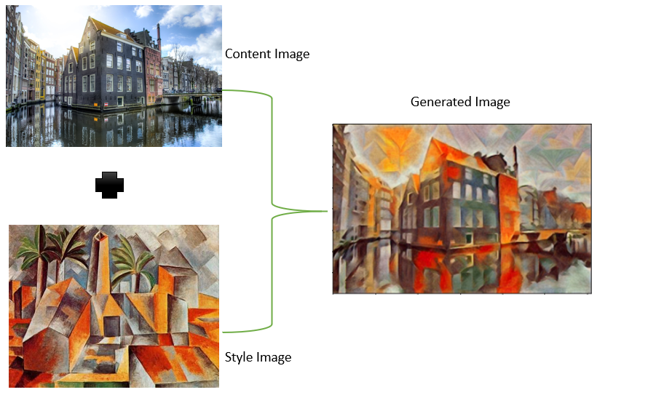
Aim
We propose an extension to the original neural style transfer technique by
Combining multiple style images using Cascade Style Transfer
Evaluating against quantifiable factors and user-based study
Content Image
+
Existing Work
Neural Style Transfer (NST) is a method of applying the style of one image to the content of another image
There is still room to grow in stability, quality, flexibility, and evaluation
Cascade style transfer (CST) is an NST method that iteratively applies style to a content image to preserve both style and original content
Multi-objective networks (MO) use multiple style images and optimize multiple objectives, such as content preservation and style transfer, simultaneously
Output Image
Style Image
Notes:
Neural Style Transfer (NST) is a successful method of applying the style of one image to the content of another image that has room to grow in stability, quality, flexibility, and evaluation
Cascade style transfer is a method that has been used to transfer multiple styles to a single content image with the intent of improving quality and flexibility
In the past, evaluation of NSTs has been done using three factors: content fidelity, global effects, and local patterns, and user feedback has been incorporated by modifying the loss function to include user preferences
A Multi-objective network is an architecture that has been used to optimize multiple objectives at once (such as content preservation and style transfer)

Slide 3
What is Novel in our Approach and Why?
HYPOTHESIS
Using Cascade Style Transfer for Multiple Style Transfer enables generation of images that incorporate multiple styles with better quality and style preservation.
Key Insights:
Adding multiple styles in MO can lessen the impact of each individual style [1]
CST is shown to improve the stylistic quality and flexibility of the generated image [2]
Style is known to be preserved more in CST, while in MO, content is known to be preserved more [2]
Existing literature on using CST for Multiple Style Transfer has not been found yet
Standard quantifiable metric implementation to measure NST performance does not exist, currently most studies rely on qualitative evaluation alone
[1] http://cs231n.stanford.edu/reports/2017/pdfs/428.pdf
[2] https://www.sciencedirect.com/science/article/abs/pii/S1077314221000473?via%3Dihub
Notes:
40 seconds

Slide 4
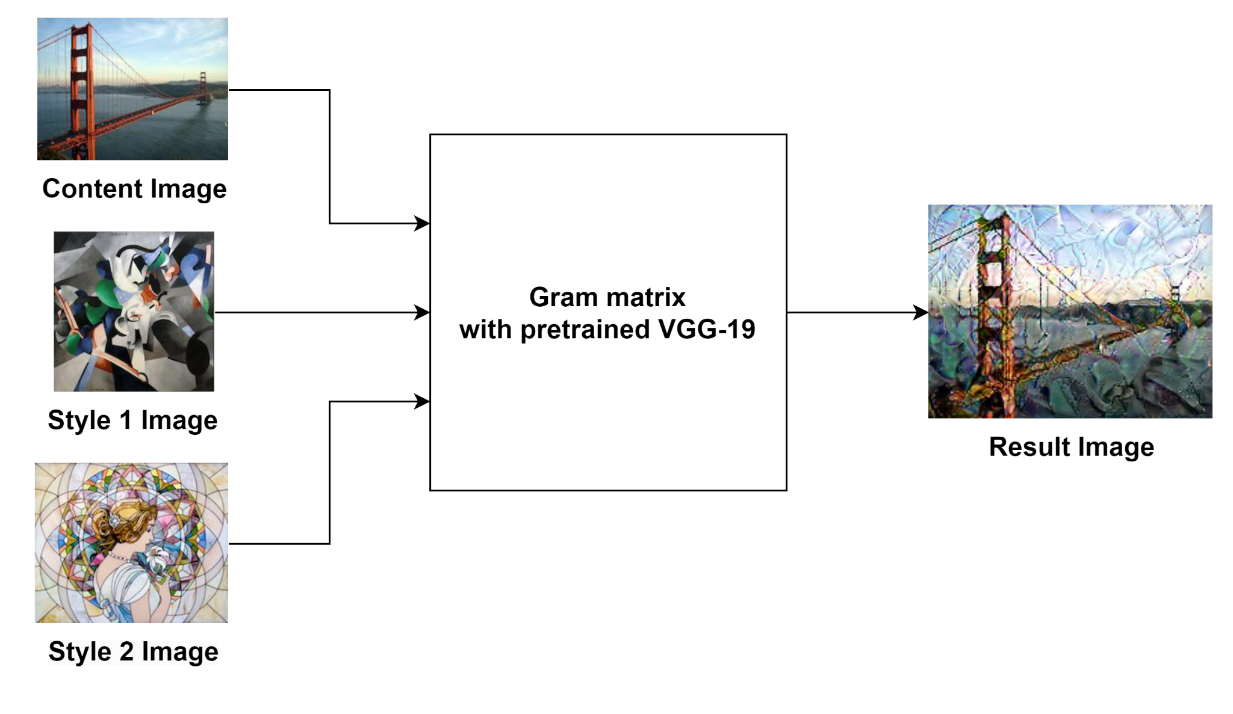
Methodology
Run three sets of experiments to combine different architectures in Serial Style Transfer (SST) and compare it to a baseline MO model
Evaluation: Implement three quantitative evaluation metrics from scratch and design User-based qualitative evaluation to support it
Baseline: Multiple Style Transfer using MO model
Notes:
40 seconds - entire time 1 min 15sec

Slide 5
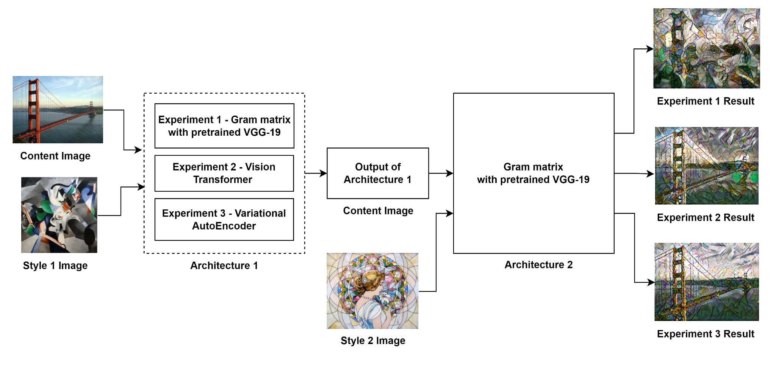
Experiment Design
Experiments conducted using multiple models for Architecture 1 in Serial Style Transfer

Slide 6
Evaluation - Quantitative (Meaningful Numbers!)
We managed to implement three major quantitative metrics - Content Fidelity, Global Effects and Local Patterns
There was no open sourced implementation available for these metrics that we could find (so a big contribution by us!)
Content Fidelity - The extent of preservation of content in the output image
Global Effects - Average of 2 components calculated for the output image with respect to the style image
Global Colors measures the similarity of the two color distributions
Holistic textures measures the similarity of the overall textures of the two images
Local Patterns - Average of 2 components calculated for the output image with respect to the style image
Difficult to implement efficiently (Algorithms class was useful!) as creating and comparing every pair of patches was required for both images
The first component measures how well the patterns are transferred (LP1)
The second compares the variety of patterns transferred (LP2)
Notes:
45 seconds

Slide 7
Evaluation - Qualitative (User Study!)
User study was designed using google forms (Based on TA Feedback - Thank You Bingjie!) which attracted over 30 responses (technical users were targeted)
Questions asked in the google form were:
Which of the resulting images above is able to preserve the original Content image? (Content Fidelity)
Which result image has a similar color palette and textures compared to the two style images shown above? (Global Effects)
Which resulting image has more lines/edges/patterns from the two style images show above? (Local Patterns)
Which image do you feel is overall able to contain both the styles and visually pleasing? (Overall Quality)
Our calculated quantitative metrics are validated by the overall qualitative results, which are presented in greater detail in the results section of our slides
This resonance confirms the reliability of both our user study and our numerical data
Notes:
25 seconds

Slide 8
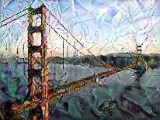
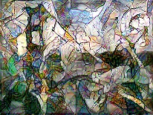
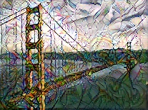
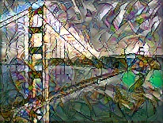
Observations
Metrics |  | Multi-Objective | VGG + VGG | VAE + VGG | Transformer + VGG
Content Fidelity |  | 0.38 | 0.26 | 0.82 | 0.51
Global Effects | Style1 | 0.73 | 0.78 | 0.76 | 0.72
 | Style2 | 0.81 | 0.84 | 0.81 | 0.86
Local Patterns | Style1 | 0.55 | 0.51 | 0.49 | 0.42
 | Style2 | 0.53 | 0.59 | 0.43 | 0.49
Q | Human Survey Question | Multi-objective | VGG | VAE | Transformer
 | Which of the resulting images above is able to preserve the original Content image? | 100.00 | 0.00 | 100.00 | 40.00
2. | Which result image has a similar color palette and textures compared to the two style images ? | 26.67 | 46.67 | 6.67 | 20.00
3. | Which resulting image has more lines/edges/patterns from the two style images? | 0.00 | 46.67 | 13.33 | 40.00
4. | Which image do you feel is overall able to contain both the styles and visually pleasing? | 33.33 | 0.00 | 46.67 | 20.00
Notes:
30 seconds
Observations for the metrics CST VS MO described were that :
Content Fidelity increased
Global Effects Slightly in both directions
Local Patterns Decreased
In parallel to the metrics when asked to users :
In each category larger percentages were picked towards Cascaded Networks
Especially in third question for LP, None picked MO networks and favoured CST
And finally Overall Winner was Cascade Network

Slide 9
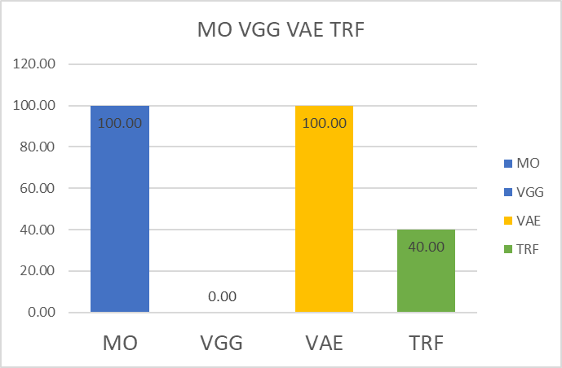
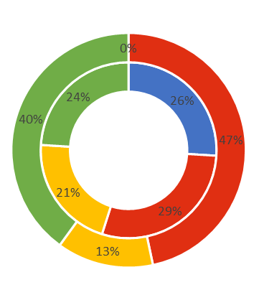
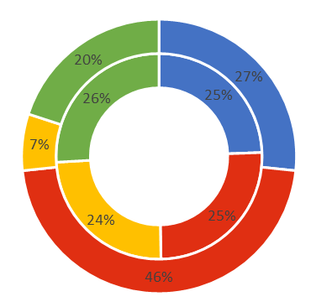
Results
Metrics | Content Fidelity | Global Effects | Local Patterns
Hypothesis | CF_{CST} ,CF_{MO} are independent | GE_{CST} > GE_{MO} | LP_{CST} > LP_{MO}
Result | Coherent to hypothesis, Increases, mutually exclusive, within the bounds, Preserves content fairly | Slightly varied in both directions, i.e mixed distribution, matching color palette-texture expectations | Decreases, Style parameters Lines and edges are better preserved, supports our hypothesis
MO VGG VAE STTR
User
evaluation
User
evaluation
MO VGG VAE STTR
Metrics
Metrics
Notes:
35 seconds
CF values are independent and match our hypothesis as are mutually exclusive and within the bounds preserving content fairly. We can see they are independent as users could pick multiple options.
GE slightly varies in both directions, matching color palette-texture expectations
LP Decreases, but everyone picked CST against that parameter, with 0 MO picks.
Blue area denotes MO and rest is CASCADE and we can clearly see those areas are higher on the outer circle as well as coherent to inner circle

Slide 10
Conclusion
Content is equivalently preserved in Cascade Style Transfer as in Multi-objective
Style qualities like Color palette and texture is more preserved, true to our hypothesis
Style patterns like lines edges and patterns are significantly preserved in Cascade Style
Notes:
20 seconds
Content is equivalently preserved in Cascade Style Transfer as in Multi-objective
Style qualities like Color palette and patterns like lines edges and patterns are preserved more in CST true to our hypothesis.

Slide 11


Future Scope
Extending cascade style alternate architecture approaches like Parallel Style Transfer
Investigating the original loss function to extend to multiple images optimally
Enhancing image based on user feedback streamlined to existing neural style models
Mapping user-evaluation to current metrics for adjusting different metrics of an image
Notes:
Extending cascade style alternate architecture approaches like Parallel Style Transfer and extend to multiple images
Additionally enhancing the image based on user feedback mapping to metrics and user study

Slide 12
THANK YOU
Team 4D Tensor
Praveen Iyer
Sneha Bandi
Swarnita Venkatraman
Neha Chawla
Guiding TA
Bingjie Tang

Slide 13
Agenda
Aim
Related Work
What is novel in your approach?
Experimental Design
Evaluation
Key Takeaways
Results
Future Scope
Slides : 2/3 Aim+ related work : Neha
Slides : 4/5 Swarnita (novel approach + Experiment design)
Slides : Evaluation Metrics (Theory and Implementation details) : Praveen
Slides : Key Takeaways & Results : Sneha
Slides : Future : Neha // Content Completed (-Sneha)

